Slide 1



DUPLICATE FILE REMOVER
Efficiently Clean Your Storage
Group Details:
Roll No. | Name
71229 | Shaikh Sohail Chand
71226 | Shinde Pratik Chandrakant
71228 | Rasal Dipak Barku
Date : 22/03/2025
Frontend Code Overview
HOME PAGE
Introduction
How It Works
Frontend Code Overview
JSON Data
Key Features
Benefits
Future Enhancements
Conclusion

Slide 2


What is Duplicate File Remover?
- A tool to identify and remove duplicate files from a computer
or storage device.
- Helps free up disk space by deleting unnecessary duplicate files.
- Improves system performance and organization.
- Features :
- Scan folders for duplicates.
- Delete duplicates with a single click.
- Save deletion history in JSON format.
HOME PAGE
Introduction
How It Works
Frontend Code Overview
JSON Data
Key Features
Benefits
Future Enhancements
Conclusion

Slide 3
How It Works?
Select Folder: Choose the directory to scan.
Scan for Duplicates: The tool identifies files with identical content.
Review Results: View a list of duplicate files.
Delete Duplicates: Remove duplicates with confirmation.
Save History: Deletion details are saved in a JSON file.
PREVIEW
HOME PAGE
Introduction
How It Works
Frontend Code Overview
JSON Data
Key Features
Benefits
Future Enhancements
Conclusion

Slide 4
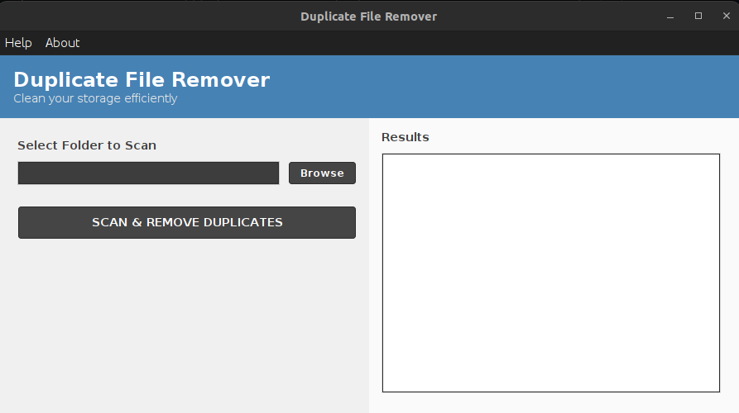
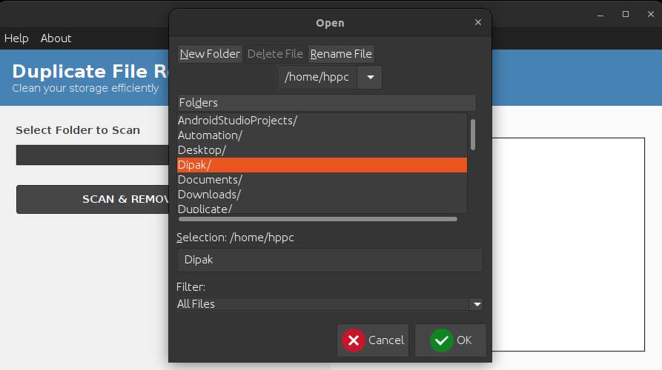
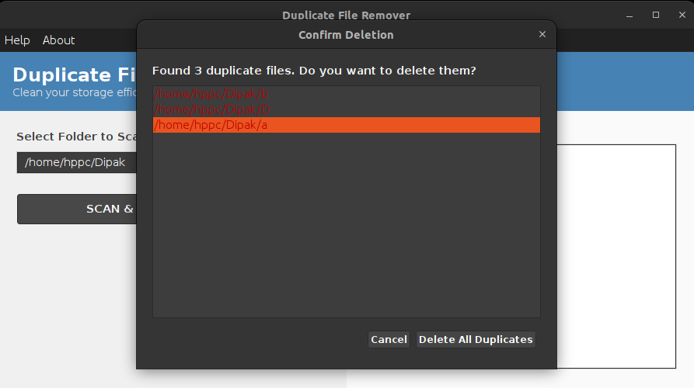
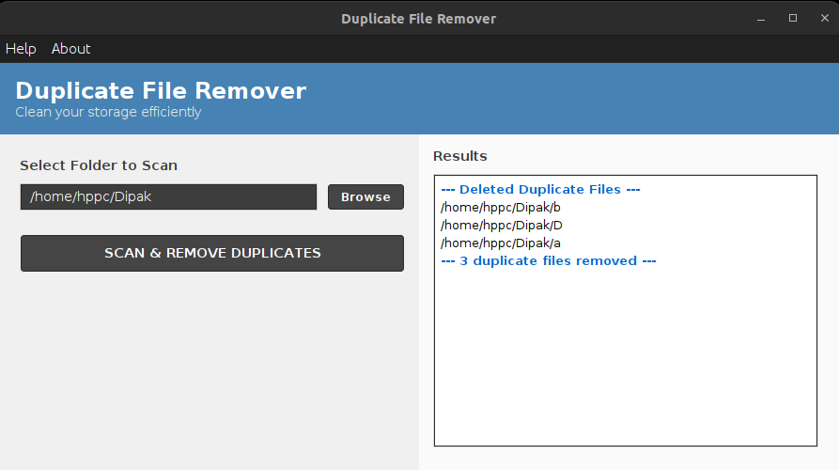
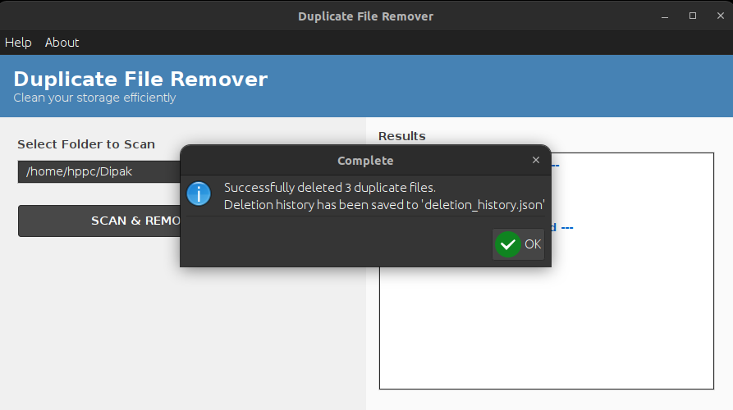
How It Works?
Open : Application
Select Folder:
Choose the directory to scan.
Review Results:
View a list of duplicate files and Confirmation.
Save History :
Deletion details are saved in a JSON file.
Delete Duplicates :
Remove Duplicates Files Successfully.
HOME PAGE
Introduction
How It Works
Frontend Code Overview
JSON Data
Key Features
Benefits
Future Enhancements
Conclusion

Slide 5

Open : Application

Slide 6
Select Folder: Choose the Directory to scan.

Slide 7
Review Results: View a list of duplicate files and Confirmation.

Slide 8
Delete Duplicates : Remove Duplicates Files Successfully.

Slide 9
Save History : Deletion details are saved in a JSON file.

Slide 10
Frontend Code (Java Swing)
- Built using Java Swing for a desktop application.
- Features :
- Splash screen with progress bar.
- System tray integration.
- Intuitive UI with buttons and lists.
- Customizable color themes.
PREVIEW
HOME PAGE
Introduction
How It Works
Frontend Code Overview
JSON Data
Key Features
Benefits
Future Enhancements
Conclusion

Slide 11
Data Saved in JSON Format
- Handles structured data efficiently, including storing and managing deletion
history to track changes, recover lost data, and ensure auditability.
- Fields :
- path: File path.
- name : File name.
- deleted_at : Timestamp of deletion (if applicable).
EXAMPLE
PREVIEW
HOME PAGE
Introduction
How It Works
Frontend Code Overview
JSON Data
Key Features
Benefits
Future Enhancements
Conclusion

Slide 12

Data saved
In JSON
FORMAT

Slide 13
Key Features
- Cross-Platform : Works on desktop Application
- User-Friendly : Simple and intuitive interface.
- Efficient : Quickly scans and removes duplicates.
- History Tracking : Saves deletion details in JSON format.
HOME PAGE
Introduction
How It Works
Frontend Code Overview
JSON Data
Key Features
Benefits
Future Enhancements
Conclusion

Slide 14
Benefits of Using Duplicate
File Remover
- Frees up disk space.
- Improves system performance.
- Reduces clutter and organizes files.
- Saves time with automated scanning and deletion.
HOME PAGE
Introduction
How It Works
Frontend Code Overview
JSON Data
Key Features
Benefits
Future Enhancements
Conclusion

Slide 15
Future Enhancements
- Cloud integration (e.g., Google Drive, Dropbox).
- Advanced filters (e.g., by file type, size).
- Multi-language support.
- Mobile app version.
HOME PAGE
Introduction
How It Works
Frontend Code Overview
JSON Data
Key Features
Benefits
Future Enhancements
Conclusion

Slide 16
Conclusion
- Duplicate File Remover is a powerful tool for managing storage.
- Available as a desktop application and web interface.
- Try it today to optimize your system!
HOME PAGE
Introduction
How It Works
Frontend Code Overview
JSON Data
Key Features
Benefits
Future Enhancements
Conclusion

